Slide 1
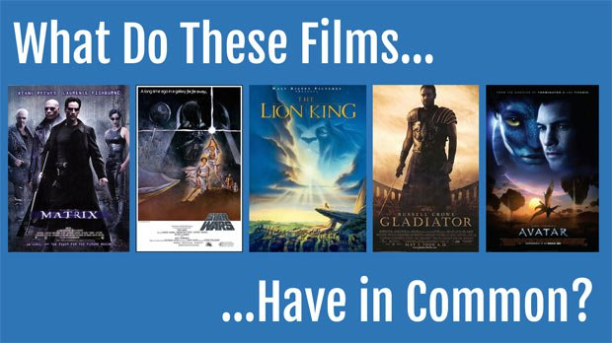
www.slideshare.net
www.digipen.edu

Slide 2
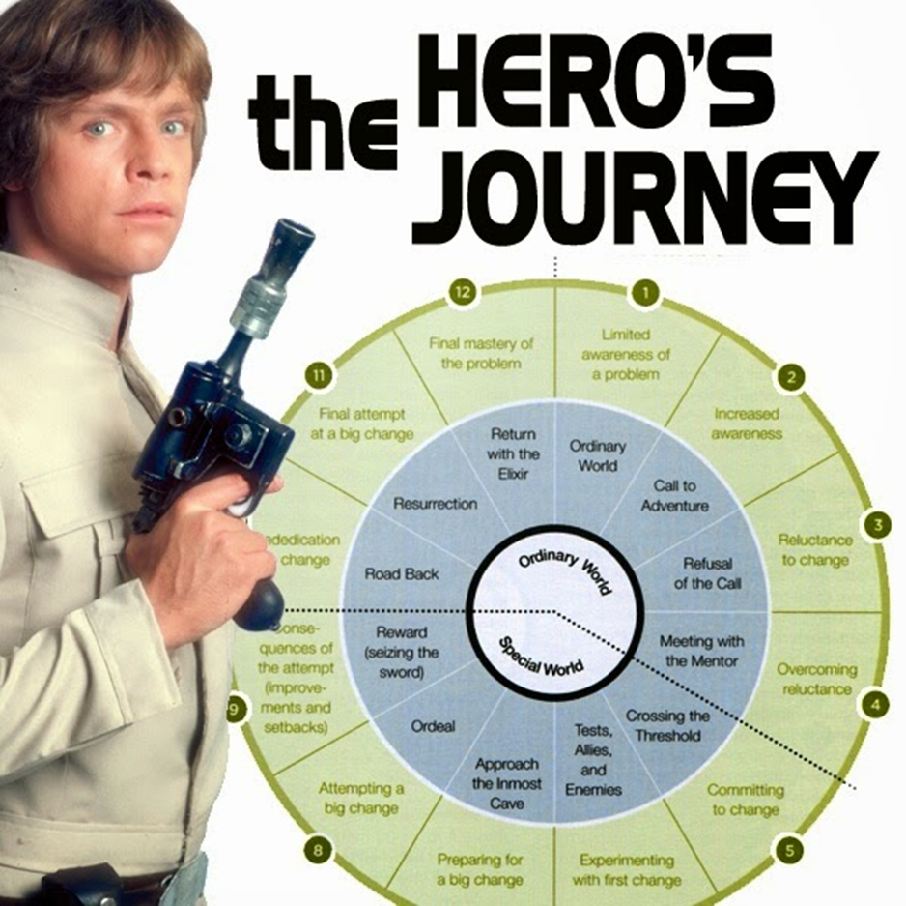
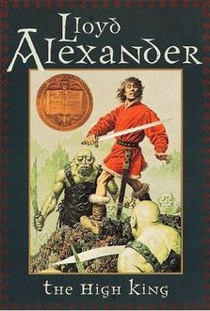
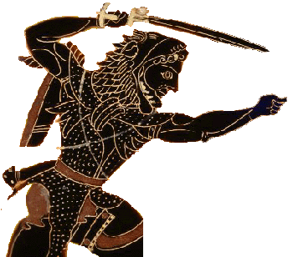
Stories from Human Beings
Novels Mythology
Hercules and his 12 labors
http://heroesstoriessource.net

Slide 3
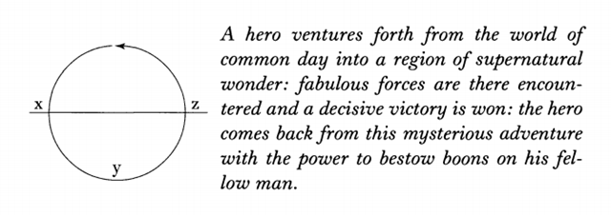
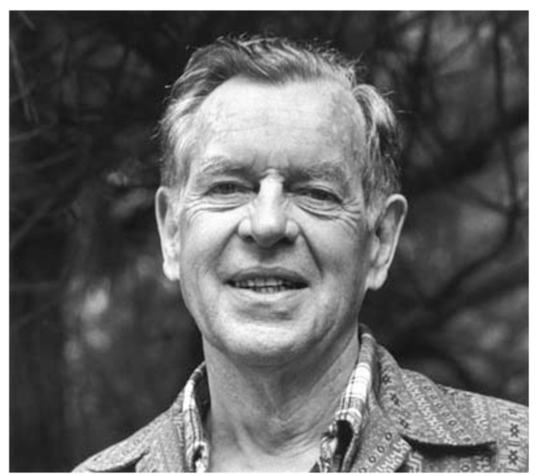
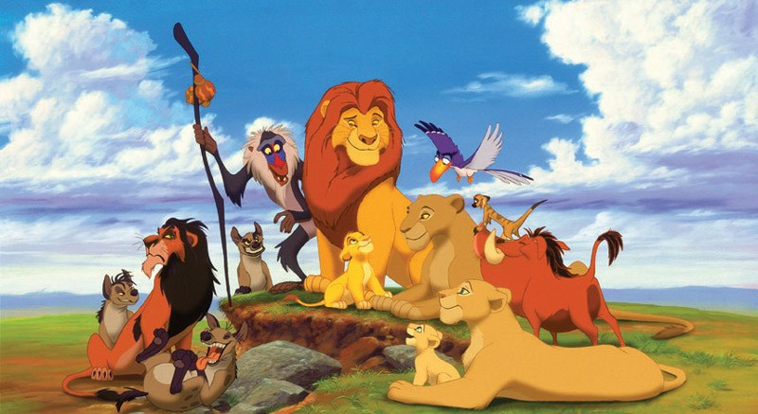
The Hero’s Journey
Where did it come from? Joseph Campbell
Why do we care about the Hero’s Journey?
It is a common theme in the history of human cultures and their mythologies.
What is a hero?
Hakuna Matata!
www.slideplayer.net

Slide 4
There are 12 Stages in the Hero’s Journey
http://cdn2-b.examiner.com/sites/default/files/styles/image_content_width/hash/25/6a/Joseph%20Campbell%27s%20Hero%27s%20Journey%20-%2012%20steps%20and%207%20characters%20CLIP_1.jpg?itok=VCSIyyj-

Slide 5
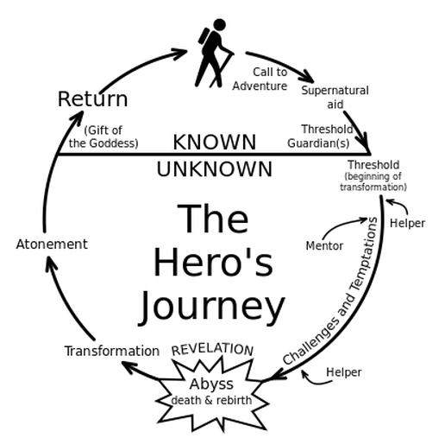
www.thinglink.com

Slide 6
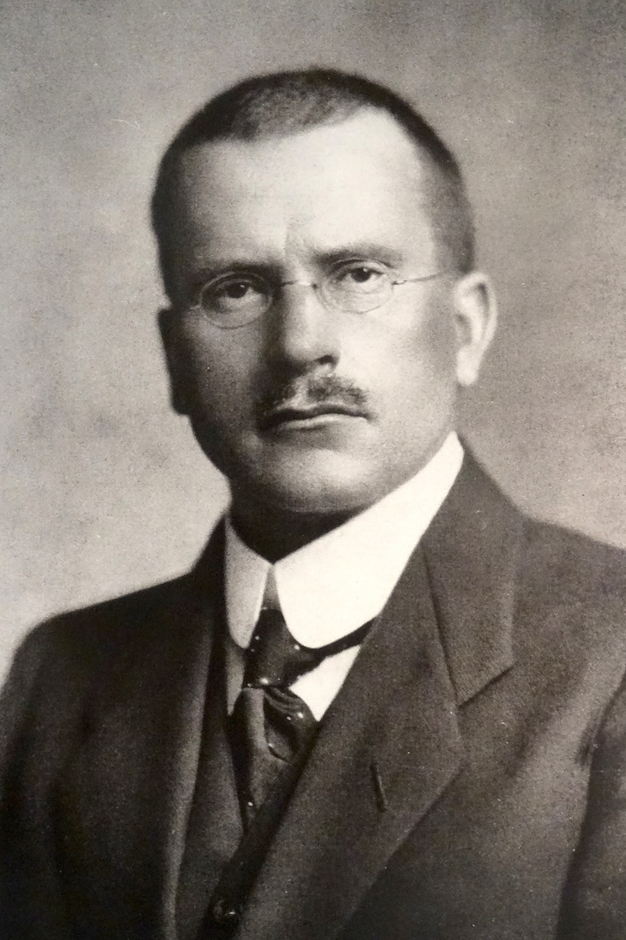
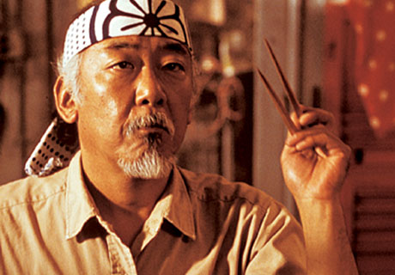
Archetypes and Carl Jung
www.pinterest.com

Slide 7
Hero’s Journey also applies to your life!
www.herojourneylife.com

Slide 8
Galileo's Triumph
They said that I could not discuss, The living facts of the universe; For to them the Earth was the center, Not the Sun; It seems I have won, The battle of the wits; For you see I am alive even though I appear to be dead, Those silly little twits; Now the astronomers of today have discovered, That there are many other universes with a sun at their center; I was tried and arrested by the Inquisition, A mathematician, astronomer, and philosopher I was; Respected and revered by my friends and allies, Then they threw me to the sharks; Watched me wiggle, In the end I triumphed; Because I am now in the heavens where I belong, Singing a very sweet victorious and glorifying song!

