Slide 1
Michael Layne Turner
Always keep your eye on the big picture!

Slide 2
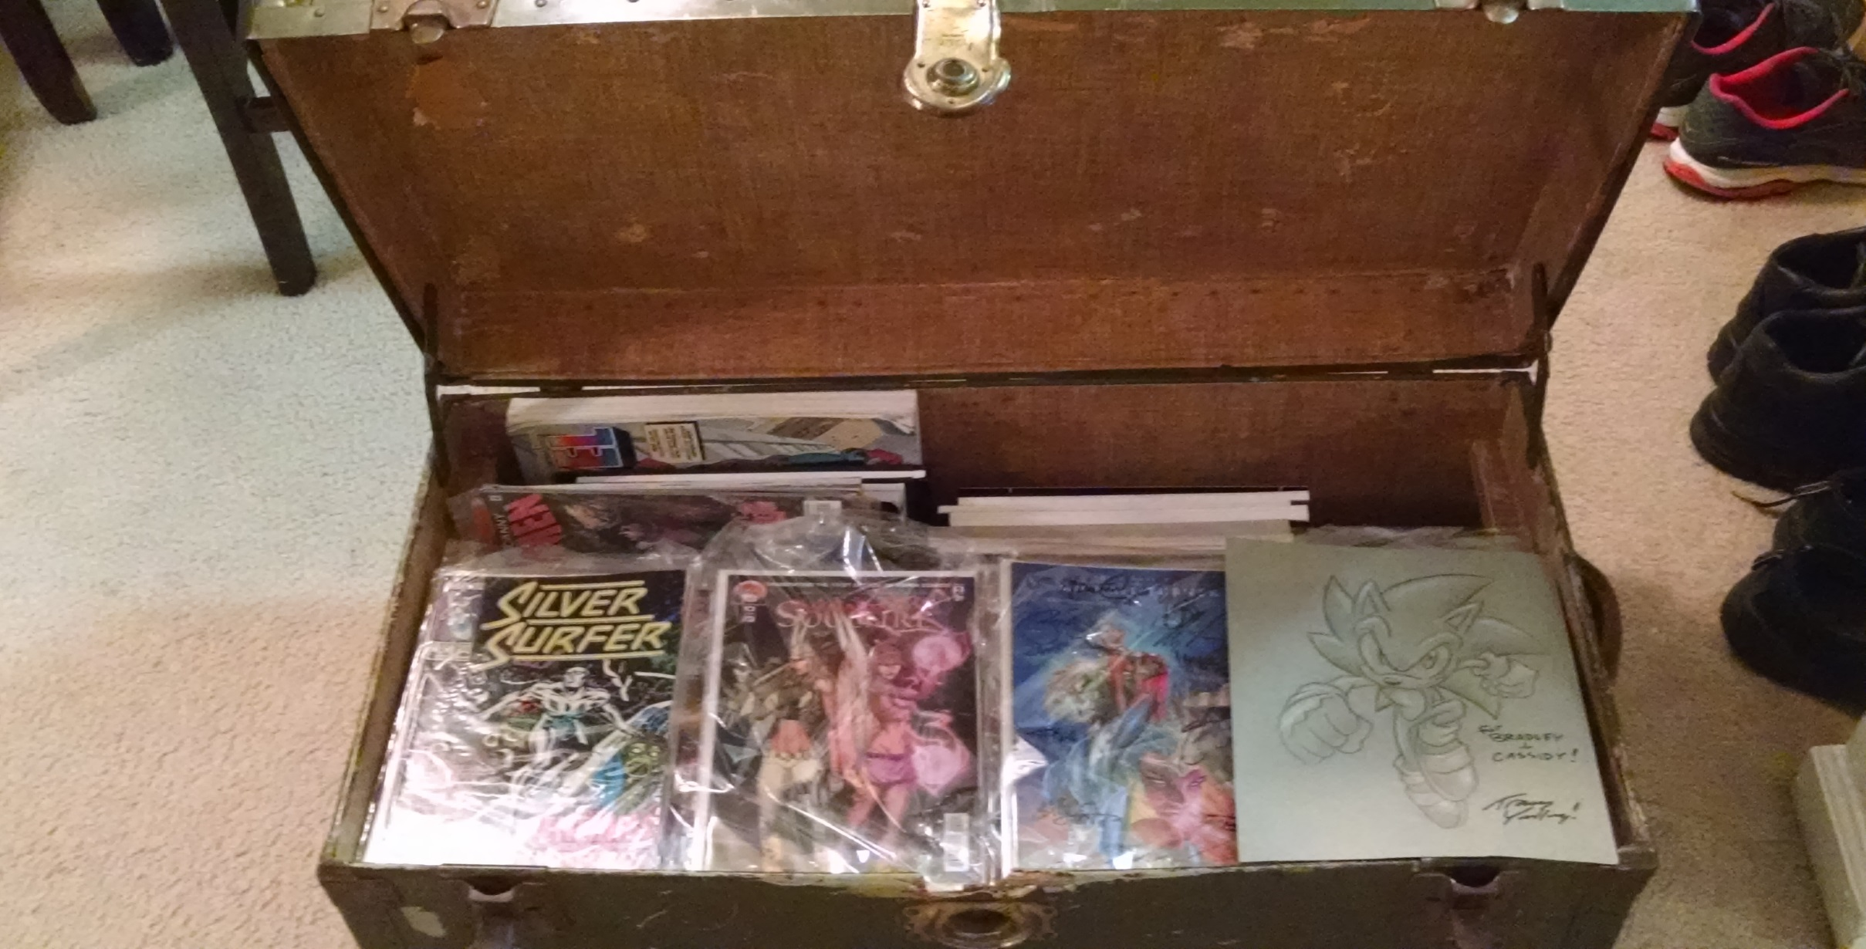
I am a comic book fan

Slide 3
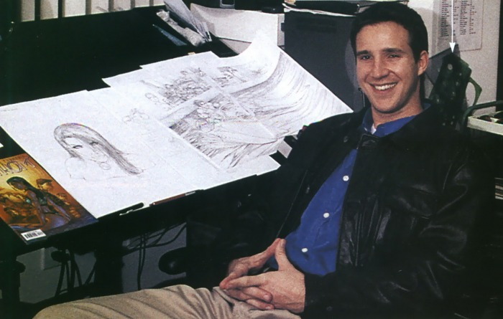
Michael Layne Turner
http://asgardian-artworks.weebly.com/in-memoriam.html

Slide 4
Top Cow Comics
http://www.topcow.com/

Slide 5
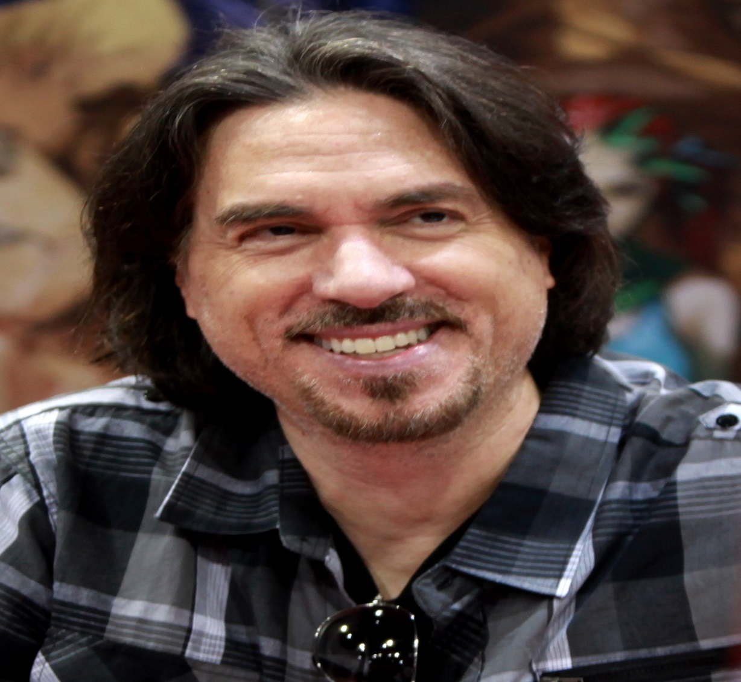
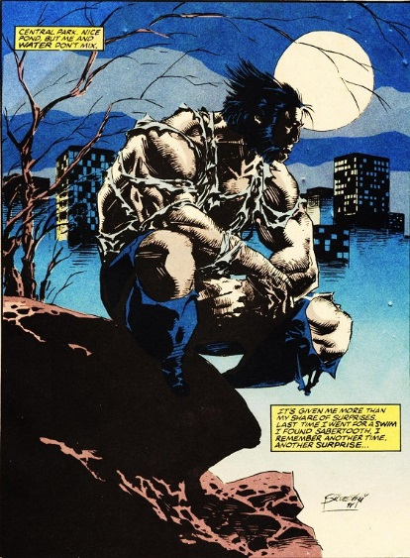
Marc Silvestri of Top Cow
https://www.expertcomics.com/en-us/news/marvel-comic-news/1990/the-definitive-wolverine-full-page-bleed
http://www.topcow.com/

Slide 6
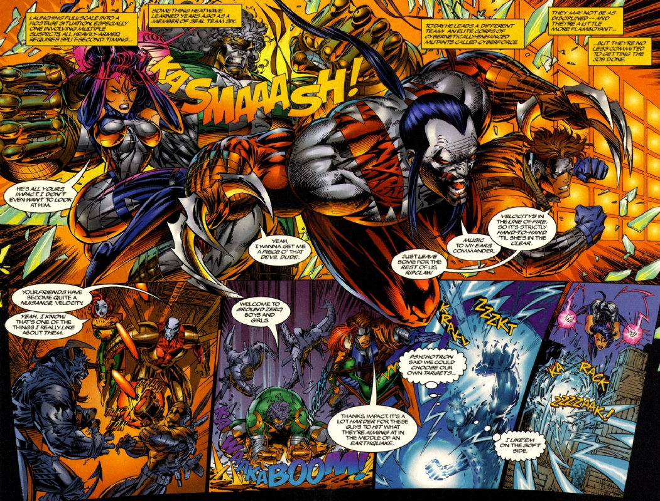
Marc Silvestri artwork
http://www.comicartfans.com/gallerypiece.asp?piece=554384

Slide 7
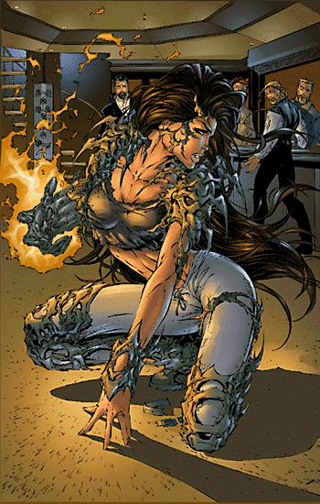
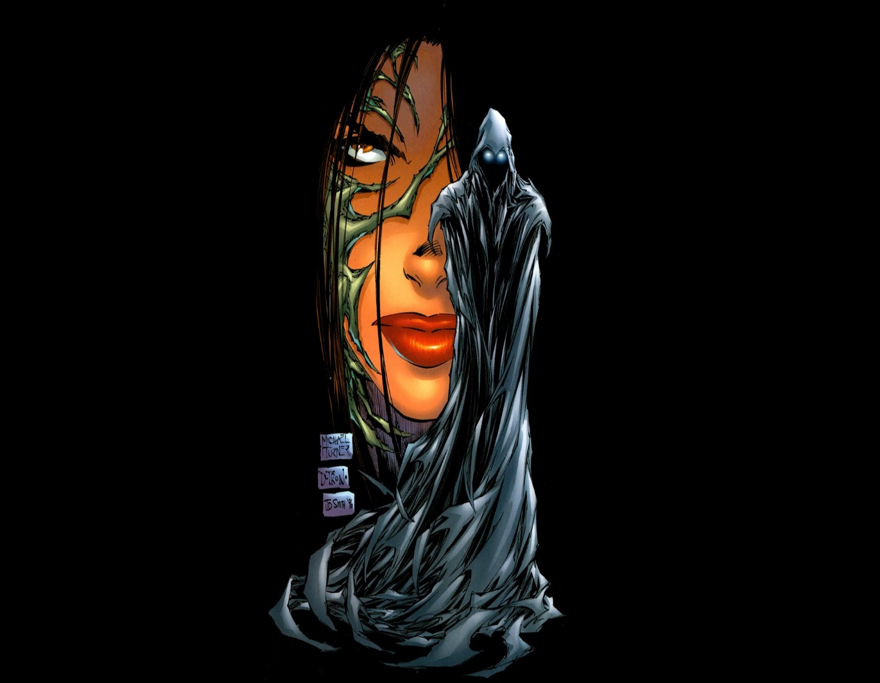
Michael Turner co-creates Witchblade for Top Cow
https://www.pinterest.com/pin/214202525998529949 http://123hdwallpapers.com/witchblade-black-background-top-cow-sara-pezzini-comics-michael-turner-illustration-glowing-eyes-game.html

Slide 8
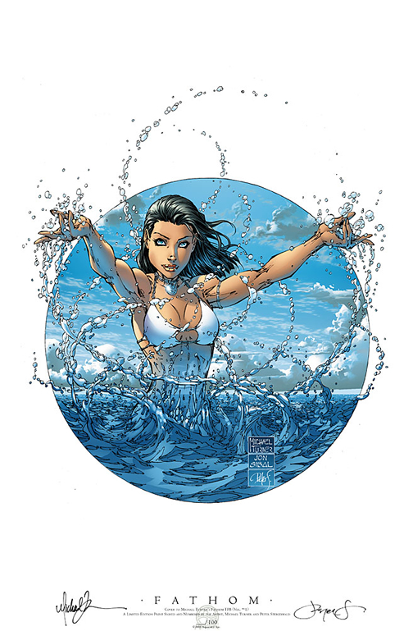
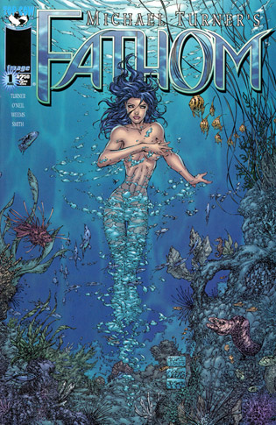
Michael Turner creates Fathom for Top Cow in 1998.
www.aspencomics.com
http://www.comicobsessions.com/news.asp

Slide 9
Michael Turner leaves Top Cow to form Aspen, MLT in 2002
www.aspencomics.com

Slide 10
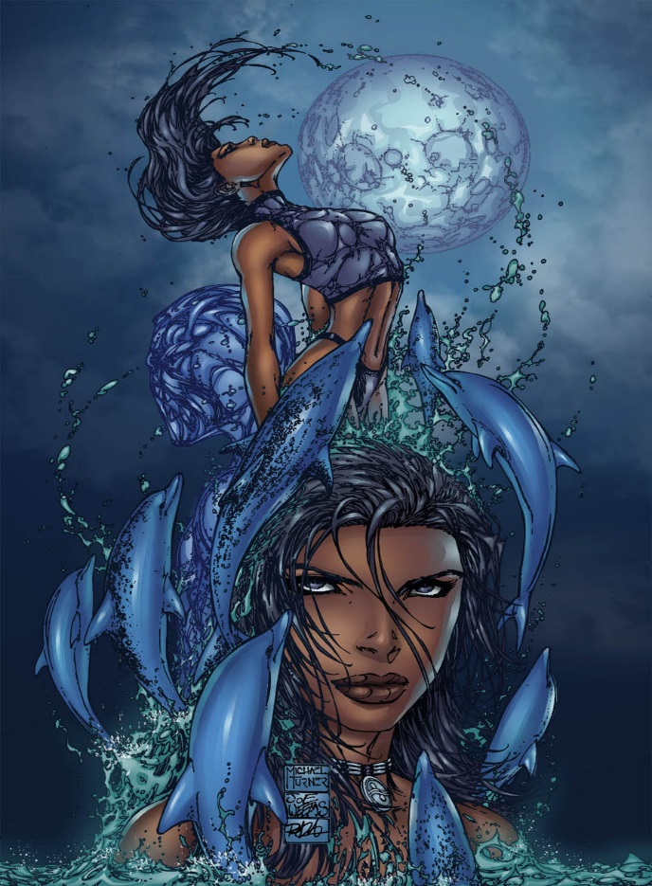
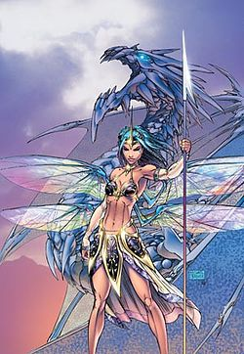
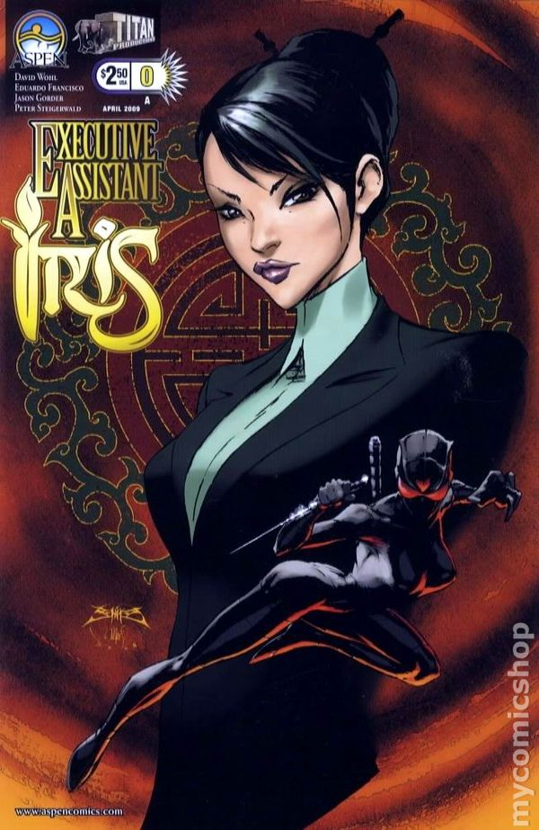
Aspen Comics characters
FATHOM
SOULFIRE
EXECUTIVE ASSISTANT
www.aspencomics.com

Slide 11
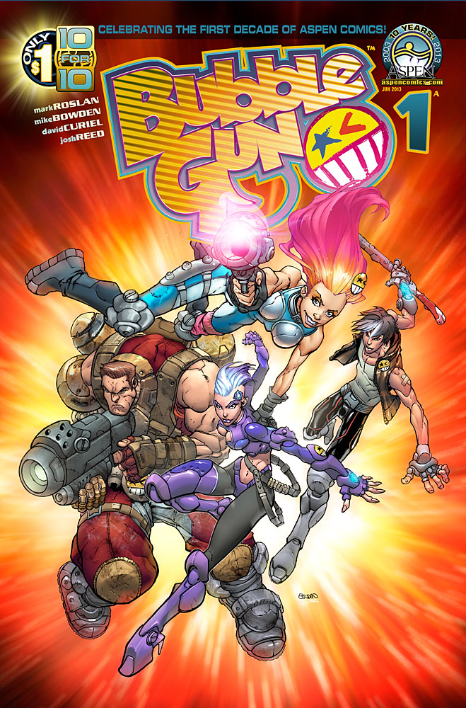
Aspen Comics characters
www.aspencomics.com
BUBBLEGUN

Slide 12
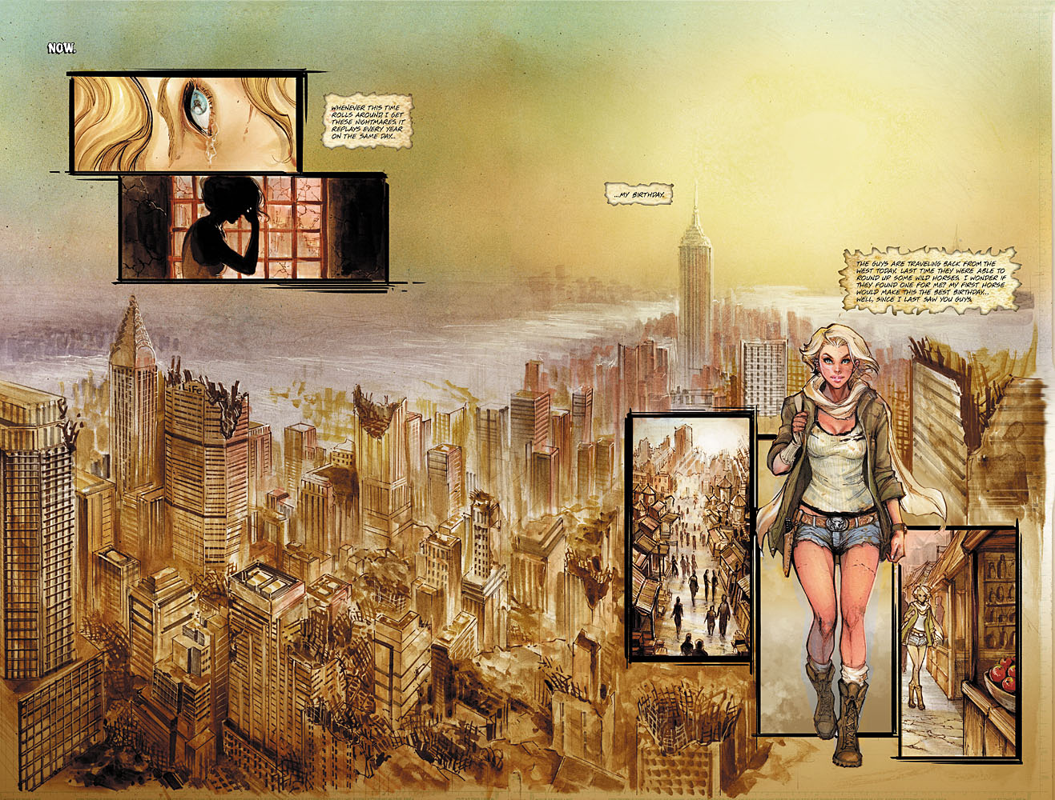
Lola XOXO

Slide 13
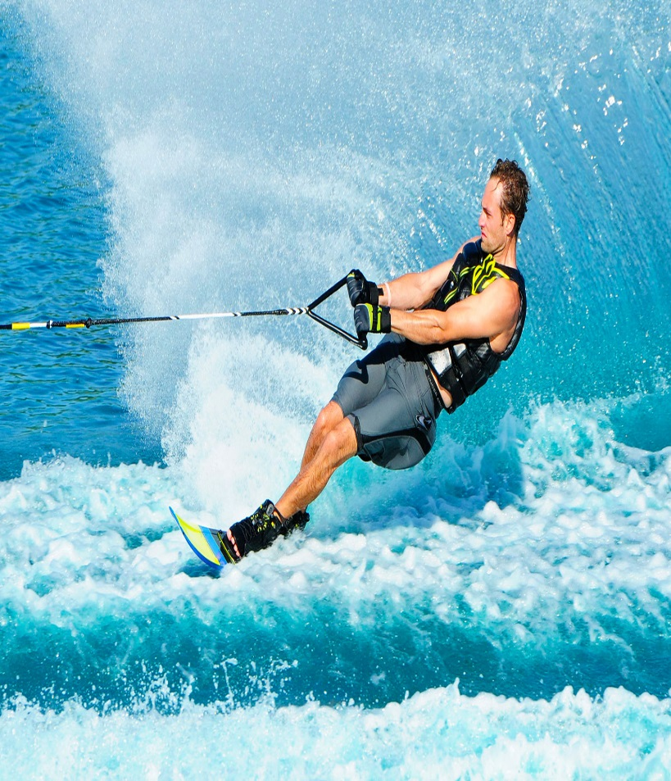
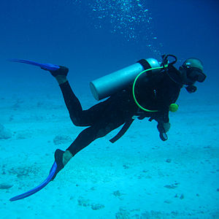
Michael Turner’s Active Lifestyle
http://www.123rf.com/clipart-vector/kung_fu.html
www.skipressmag.com
https://www.adavegastravel.com/tours/kusadasi-scuba-diving/

Slide 14
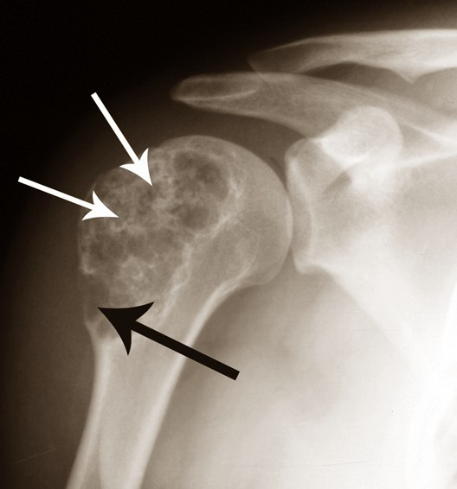
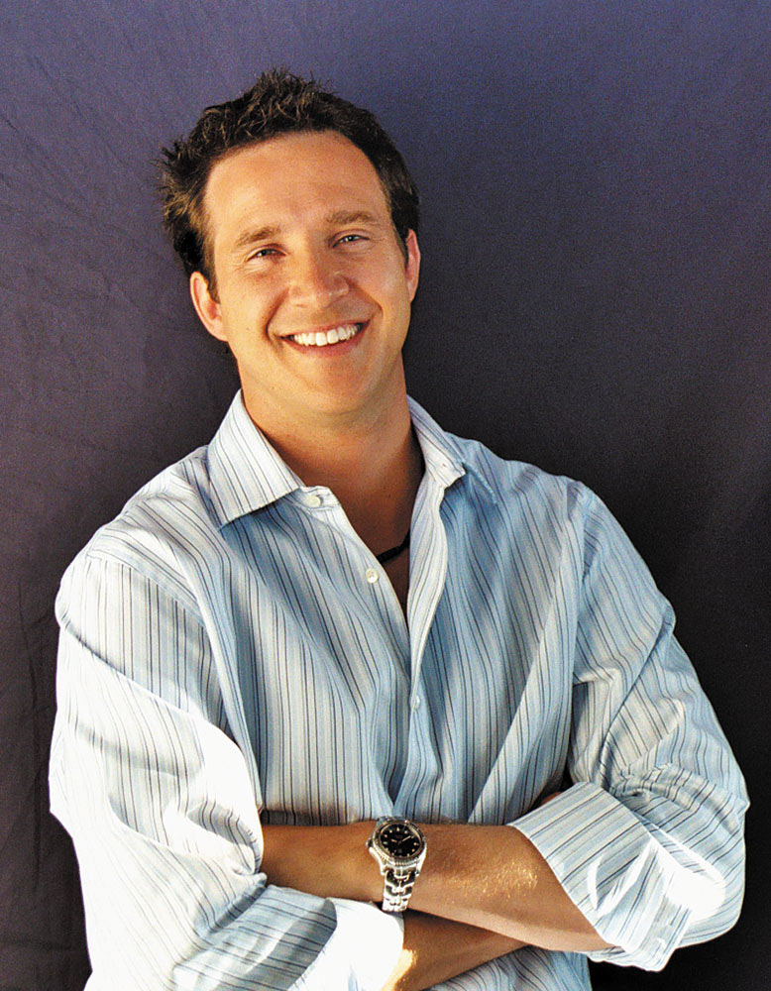
Michael Turner’s contracts bone cancer in 2000
http://mddk.com/chondrosarcoma.html
http://www.findagrave.com/cgi-bin/fg.cgi?page=gr&GRid=82381646

Slide 15
Top Cow sues Michael Turner for Fathom and Soulfire
www.aspencomics.com

Slide 16
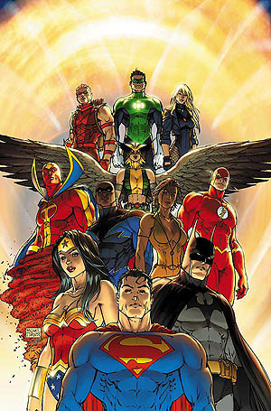
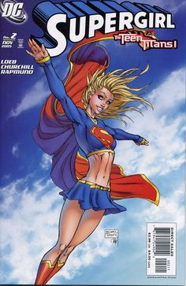
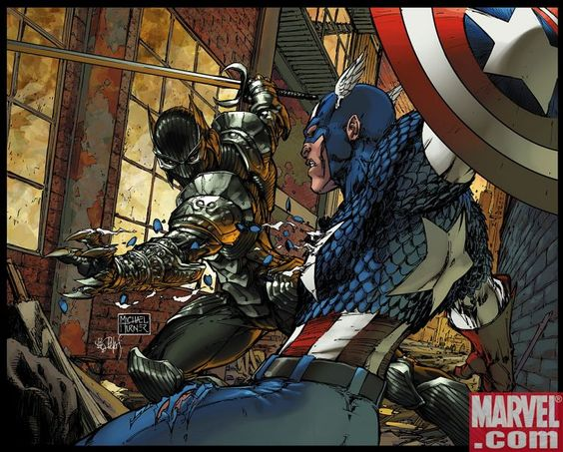
Michael Turner Covers for DC and Marvel
www.comicartcommunity.com
https://www.pinterest.com/pin/474637248202876436/

Slide 17
Michael Turner Draws Heroes Web Comic for NBC
http://usatoday30.usatoday.com/life/television/news/2007-07-25-heroes_N.htm

Slide 18
Top Cow Lawsuit settled in 2004. Aspen Comics is given rights to characters. Michael Turner’s company flourishes.
www.aspencomics.com

Slide 19
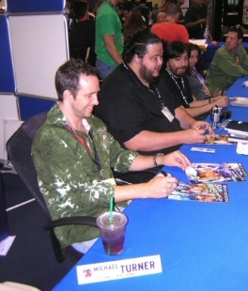
Michael Turner was always happy even when his cancer was causing him pain
“My philosophy is smile more than you don’t smile!”
----Michael Turner
www.speakgeekytome.com

Slide 20
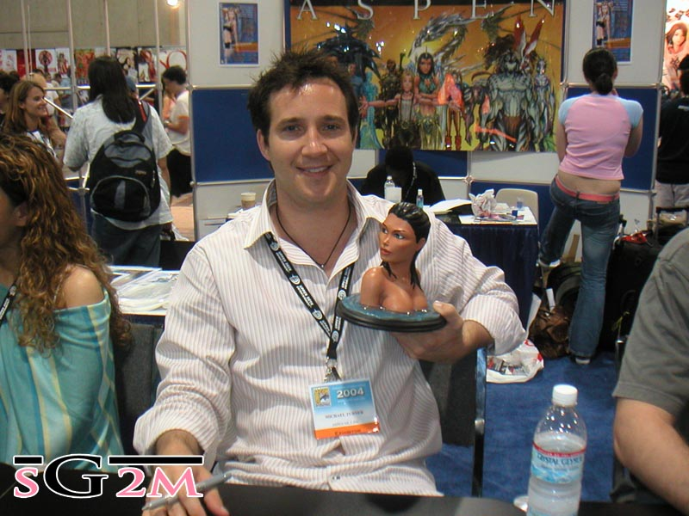
Michael Turner was always happy even when his cancer was causing him pain
www.speakgeekytome.com

Slide 21
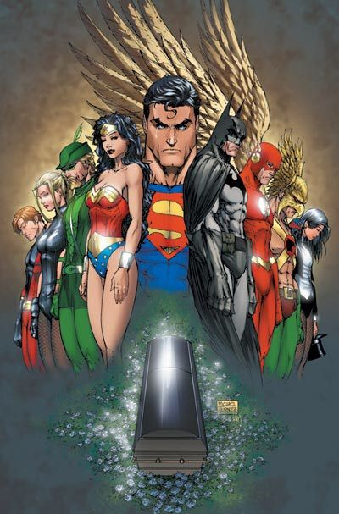
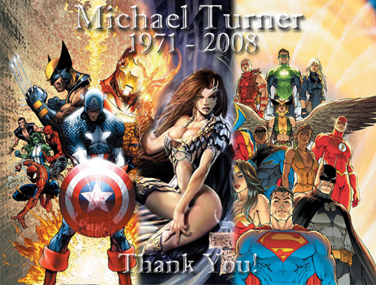
Michael Turner passed away on June 27th, 2008 due to complications from bone cancer
http://asgardian-artworks.weebly.com/in-memoriam.html

Slide 22
Michael Turner was always happy even when his cancer was causing him pain
“Life is full of stupid little things. There’s no sense in being upset about things you can’t do anything about. So go do the stuff you can do. You just need to keep your eye on the big picture.”
----Michael Layne Turner
http://www.findagrave.com/cgi-bin/fg.cgi?page=gr&GRid=82381646

